Slide 1
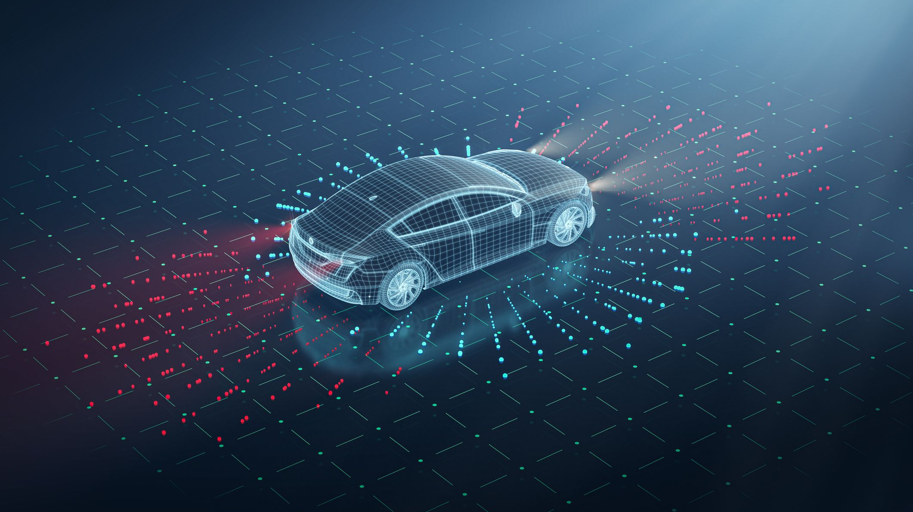
AUTONOMOUS DRIVING
Driving Innovation, Inspiring Journey.
Kumar Aryan – Partner
Quiwen Wang – Project Manager
Abhijit – Consultant Analyst
Raj - Data Analyst

Slide 2

WHO WE ARE
Mission: Revolutionize the driving experience by providing expert and personalized consulting services.
Operating Model: Technology Infrastructure
Team Constellation: Partner, Project Manager, Consultants, Analysts, Staffs.

Slide 3

Industry Info
Largest car manufacturer in the World.
The Volkswagen brand employs more than 170,000 employees.
Reporting a sales revenue of 322.3 billion euros and profit of 22.6 billion euros in 2023.
Increased by 34.7% to 771,100 fully electric vehicles in 2023(2022: 572,500).
Major companies owned by Volkswagen :- Audi, Seat, Bentley, Skoda, Bugatti, Lamborghini, Porsche, Ducati, Volkswagen commercial vehicles.
118 locations worldwide, including 70 plants dedicated to car manufacturing.

Slide 4






Reasons of Declining Market Share
Main Competitors
Supply Chain Disruptions
Economic Factors
Regulatory Challenges
Product Issues
Competition
Consumer Preferences
Brand Perception

Slide 5

Top 3 Technical Challenges
Sensor Fusion and Perception
Integration of Sensor Data
Environmental Variability
Object Recognition and Tracking
Decision-Making and Planning
Complex Decision-Making
Safety and Ethical Considerations
Human-Vehicle Interaction
Reliability, Redundancy, and Fail-Safe Systems
System Reliability
Redundancy and Backup Systems
Validation and Verification

Slide 6

Approaches and Opportunities
Product Innovation and Differentiation
Invest in Electric Vehicles (EVs)
Focus on Quality and Reliability
Diversify Product Portfolio
Customer-Centric Approach
Enhance Customer Experience
Listen to Feedback
Market and Competitive Analysis
Monitor Competitors
Adapt to Market Trends
Supply Chain Management
Brand Management and Reputation Repair
transparent communication with consumers
enhance Volkswagen's brand reputation
Strategic Partnerships and Collaborations
Technology Partnerships
Industry Collaborations

Slide 7
SWOT Analysis
Strength:
Strong Brand Reputation.
Financial Strength.
Extensive Vehicle Portfolio.
Strategic Partnerships.
Opportunity:
Growing Market Demand.
Technological Advancements.
Sustainability Trends.
Weakness:
High Costs.
Regulatory Challenges.
Complex Legacy Systems.
Threats:
Intense Competition.
Cybersecurity Risks.
Legal and Ethical Issues.
Economic Uncertainty.

Slide 8
OUR RECOMMENDATIONS
Leverage Brand Reputation
Utilize Financial Strength
Expand Vehicle Portfolio
Manage High Costs
Address Regulatory Challenges
Modernize Legacy Systems
Capture Growing Market Demand
Invest in Technological Advancements
Stand Out in a Competitive Market
Enhance Cybersecurity Measures
Adapt to Economic Fluctuations

Slide 9
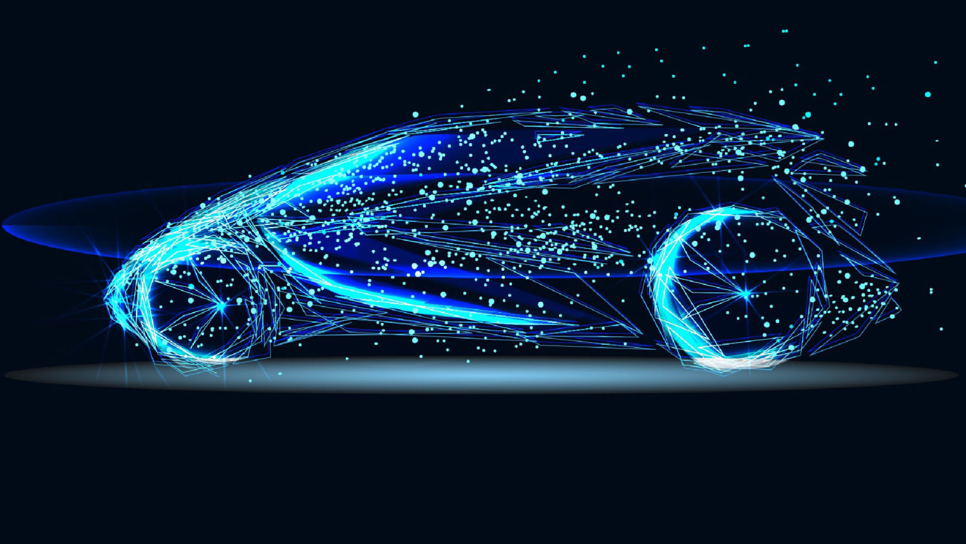
THANK YOU

